Slide 1
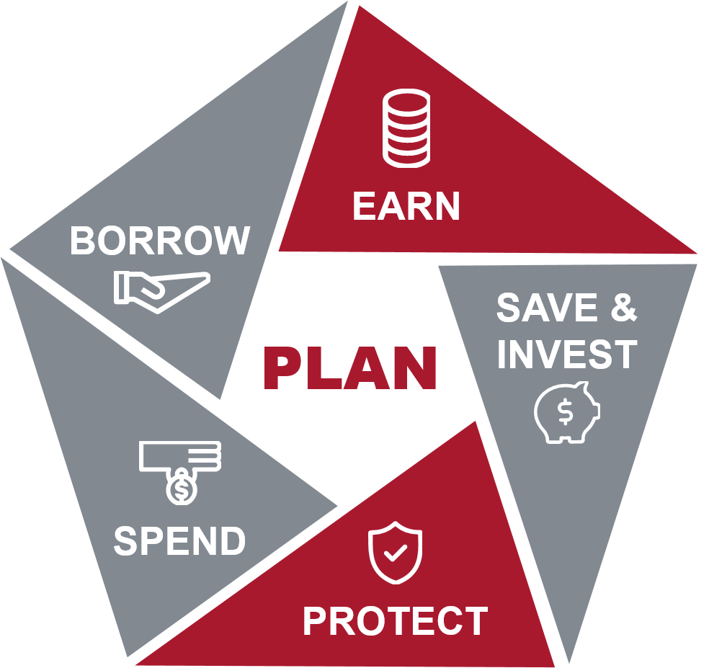
Managing Your Finances Post-Deployment
Advanced
Version 1.1
Personal Financial Management Curriculum
Notes:
Lesson Introduction: 2 minutes.
Introduce the lesson.
Before returning home, it is important to understand that things may have changed during your absence. Be prepared for a transition as you reunite with family, friends, and/or co-workers. This period of readjustment will take time, patience, and understanding.
In addition to the emotional process of reuniting with your family, returning home can also present some practical challenges that need to be addressed. If you have a spouse, ensure you have a discussion together about the budget, and gradually reintegrate yourself back into the family financial routine.
When returning from deployment, you may find that you are in your best financial position ever. You may have a sizable nest egg in your bank account because of your combat pay and tax savings. If you are active duty, you have access to free financial planning and accounting services through your Marine Corps Community Services.
For some, returning from deployment may be difficult financially. This may be because you had trouble tracking bills or had difficulty meeting financial obligations while you were away. Or, possibly, you had family members at home who mismanaged money. You may also be in transition, moving or changing jobs with no current income. Finally, it may be hard for you and your family to cut back now that you are not receiving tax-free, combat zone benefits anymore.
This lesson will discuss the financial areas you need to review upon your return.

Slide 2

Lesson Objectives
Use effective communication skills when discussing finances with family members
Identify key documents and accounts to review upon your return
Compare your post-deployment finances to your pre-deployment finances
Explain the process for transfer of your SDP deposit
Describe the different types of excluded pay
Explain income tax extensions for which you may be eligible
Notes:
Provide the learning objectives.
After completing this lesson, you should be able to:
Use effective communication skills when discussing finances with family members
Identify key documents and accounts to review upon your return
Compare your post-deployment finances to your pre-deployment finances
Explain the process for transfer of your SDP deposit
Describe the different types of excluded pay
Explain income tax extensions for which you may be eligible
Transition to the first topic.
We will begin this with a discussion of the reintegration process.

Slide 3

Return and Reintegration into Family Finances
Gradually reintegrate yourself back into the family financial routine
Discuss and determine the division of financial responsibilities; work as a team
Take advantage of financial assistance through your installation or Military OneSource to clarify your financial goals
Notes:
Return and Reintegration: 15 minutes.
Discuss the financial reintegration process.
While deployed you may have delegated financial decisions to a spouse or other family member.
When you return home, communicate with that person. Talk with each other about how you would like to address financial responsibilities going forward.
If you are married, be patient if your spouse is reluctant to give up the financial control he or she had while you were away.
If you decide to try a new arrangement, establish a “trial period” and check in with each other after a set period of time to adjust the division of responsibilities as needed, but remember to work as a team. Some couples split the responsibilities by having one person pay the bills and the other person file the paperwork or log in the payments on their software.
Take advantage of financial assistance through your installation or Military OneSource to clarify your financial goals.

Slide 4

Reviewing and Updating Your Finances
Review and re-establish your budget
  Make adjustments in income amounts, increases in expenses, and your current financial situation
Update your financial plan
  Review and make adjustments to goals; add new goals
  and objectives
Review and/or re-start insurance policies
  Re-establish appropriate levels of coverage; shop around for the best value
Postpone major purchases
  Wait until you have a handle on your finances
Notes:
Discuss the importance of reviewing and updating their financial plan.
Review and re-establish your budget:
Your return from a deployment will affect your income and your expenses.
Review your budget and adjust to reflect any changes in income amounts, increase in expenses, and your current financial situation.
Your budget should include contributions to savings and retirement accounts, even if the amounts are small at first.
Update your financial plan:
After any significant life event, including deployment, it is important to review how your finances have been affected and create a thoughtful plan of action to help you satisfy your financial obligations and move toward your goals.
Revise your current financial plans. You can review your goals, adjust those goals if necessary, and add new goals and objectives.
If you took advantage of any of the provisions of the Servicemembers Civil Relief Act (SCRA) make sure you know when these protections will expire and what is required of you after the expiration.
Some of the more commonly invoked provisions include:
Six percent cap on interest rates. You can reduce or cap interest rates on any credit card, mortgage, or other loan you or your spouse obtained before you entered active duty to 6 percent per year for the period you remain on active duty.
Credit Rating Protection. Lenders cannot deny or revoke credit, change the terms of an existing loan, or refuse to grant credit because you sought SCRA protections.
Judicial Relief. If you are on active duty and it prevents you from attending a scheduled court appearance, SCRA allows you to request the postponement of civil court and civil administrative proceedings—including actions involving bankruptcy, divorce, or foreclosure—for at least 90 days.
Protection against evictions. If you rent your home or apartment and the rent does not exceed a certain amount. (Contact Base Legal)
Cancellation of automobile leases. You can terminate a car or truck lease if you are called to active duty for 180 days or more after signing the lease. You also can terminate the lease if you receive orders for a permanent change of duty station outside the U.S. or are being deployed with a military unit for 180 days or more.
Relief from foreclosures and forced sales. If you are on active-duty and it results in your inability to pay your mortgage or meet the terms of a purchase or installment contract, the SCRA may be able to help you.
Termination and reinstatement of insurance. If your health insurance was canceled when on active duty, it can be reinstated without loss of benefits, waiting periods, or penalties in most instances. Life insurance also is protected against lapse, termination, and forfeiture for nonpayment of premiums or indebtedness for the period of military service plus two years. You also can cancel professional liability insurance and have that insurance reinstated.
State Tax Relief. If you receive military orders that require you to move from your home state to another state, your "domicile" or state of legal residence for tax purposes does not change. SCRA prevents you from having to pay state taxes on your military income—or personal property, such as a car—to any state other than your home state of legal residency. For more information review the Consumer Financial Protection Bureau’s (CFPB) SCRA fact sheet at https://files.consumerfinance.gov/f/documents/cfpb_servicemembers-civil-relief-act_factsheet.pdf
Review and/or restart insurance policies:
During your deployment, you may have put certain insurance policies on hold or allowed them to lapse.
Contact your insurance agent to discuss the status of your life, auto, and health insurance policies. Re-establish appropriate levels of coverage as needed.
If you are re-starting policies, this is a good time to get quotes from other providers to find the best value.
Postpone major purchases:
After enduring months of sacrifice and uncertainty, it is normal to want to celebrate. You may be tempted to purchase your dream vehicle, go on a luxurious vacation or go on a spending spree now that you are home.
The more financially savvy move is to delay spending large amounts of money until you have a solid handle on the “new normal” of your finances.
It is better to think carefully about purchases and their effect on your budget than to increase debt that may be difficult to repay or potentially put you or your family in a financially compromised situation.

Slide 5
Key Documents to Review
Credit Report
Powers of Attorney
Other Key Financial Documents
Notes:
Discuss key documents to review.
After returning from deployment, there are several important documents you should review for accuracy and/or modify if necessary.
Credit report:
Request a copy of your credit report, and if married, your spouse’s, from all three credit agencies.
Be sure to use the government website: https://www.annualcreditreport.com/index.action
Through power of attorney, you may have given authority to others to act on your behalf regarding financial matters during your absence.
You want to ensure no fraudulent activity has transpired or new accounts have been established without your knowledge or approval.
It is imperative to compare the credit history from a previous report to a more current one.
Powers of Attorney (POA):
A POA has the potential for being a helpful or a dangerous document. The important thing to remember is that you are going to be legally responsible for the acts of your agent. Therefore, you should revoke any powers of attorney that are no longer necessary.
When revoking a power of attorney, you are withdrawing the power to make financial and/or other decisions for you that you previously granted to another person.
It is a legal document, in writing, stating that you are now revoking those powers, which you earlier gave to your appointed person.
You have the right to revoke powers of attorney at any time, and the process is fairly simple.
Visit your Base Legal Services Office for further advice and guidance.
Ask:
What other financial or legal documents should be reviewed upon your return?
Possible Responses include:
Life insurance policies
Will
Living Will
SGLI beneficiary designation
TSP beneficiary designation

Slide 6

Key Accounts to Review
Military pay account
  Examine your LES
  Review and adjust allotments
  Check for pay due or overpayments
Bank and investment accounts
  Review history of transactions
  Contact financial institutions immediately to report questionable transactions
Notes:
Discuss key accounts to review.
You should also review your financial accounts. This includes your military pay account, bank accounts, and investment accounts.
Military pay account:
Your LES can serve as a reminder to terminate split-pay and to stop or change deployment allotments.
You should ensure you received all pay you were properly entitled to and to report any amounts you possibly received erroneously.
It can be alarming when a huge deduction in your normal salary happens unexpectedly, months or years later for a collection of erroneous pay previously received.
Your LES can also serve as a reminder to adjust your TSP contributions, if desired. You can do that via myPay.
Bank and investment accounts:
If you granted authority for others to have access to your bank accounts while deployed, you want to review the history of transactions that took place.
You want to ensure that your resources were properly cared for and managed as intended, as well as identify any possible errors generated by your financial institutions.
Change your passwords so that your authorized person no longer has access to the accounts.
If you had automatic monthly payments sent to your investment accounts, you should review all monthly statements generated while you were deployed.

Slide 7

Savings Deposit Program (SDP) Withdrawal
Your money will continue to draw interest for 90 days once you have returned home or to your permanent duty station
Your account will be closed, and all funds will be returned to you via direct deposit 120 days after leaving the combat zone
You may request withdrawal prior to that date
Notes:
Discuss the Savings Deposit Program (SDP) withdrawal process.
You may deposit a total of $10,000 during your deployment and will earn up to 10% interest annually.
If your account contains more than $10,000, you or your spouse can make quarterly withdrawals for the amount over $10,000. The $10,000 remains in the account until your eligibility terminates and you withdraw the remaining funds in entirety.
You cannot close your account until you have left the combat zone, although your money will continue to draw interest for 90 days once you have returned home or to your permanent duty station. Your allotment will stop upon your departure from the combat zone.
Your account will be closed, and all funds will be returned to you via direct deposit 120 days after leaving the combat zone.
If you want your funds before the 120-period ends, your myPay account provides automated request options for SDP participants. You can also request withdrawal by email, fax, or mail through DFAS.
Funds will be transferred electronically to the direct deposit account on record but may be deposited in another account you identify or by hard copy check, if you request.
Ask:
Why should you not request your funds prior to the 120-day automatic closure, if possible?
Because you continue to earn interest for an additional 90-days after your return, and that amount of interest may be substantial.

Slide 8

Managing an Increase in Savings
Avoid impulse buying or making large purchases
Identify specific financial goals and develop a financial plan
Seek professional financial assistance from your Installation’s:
  Personal Financial Management (PFM) Specialist
  Command Financial Specialist (CFS)
Notes:
Discuss strategies for managing their increase in savings.
Depending on the type and/or length of deployment or extended absence, you may have experienced an increase in income.
If you have a financial plan, you probably have identified some financial goals you would like to achieve, such as paying off or decreasing personal debt, fully funding your emergency fund, saving for a particular goal, increasing savings generally, or starting a child’s college fund. Each of these is a great way to use additional income because you are working toward accomplishing financial goals and ultimately positioning yourself for a better future financially.
It is financially savvy to avoid impulse buying, taking lavish vacations, and making large purchases with additional income, without first planning and budgeting for them.
If you have not identified any specific financial goals or developed or modified your financial plan, or you’d like help, contact your installation Personal Financial Management (PFM) Specialist or Command Financial Specialist (CFS) for assistance. Your PFM also can assist you in prioritizing your goals.
Transition to the next topic.
Now let’s talk about the impact of deployment on your taxes.

Slide 9

Income Taxes
If qualified, you can exclude certain pay from taxable income, and extend filing and tax payment deadlines
Notes:
Income Taxes: 10 minutes.
Discuss the income tax advantages of serving your country.
If you were deployed to a “combat zone,” a “qualified hazardous duty zone,” or provided direct support for operations in those designated areas for which you received Hostile Fire Pay (HFP)/Imminent Danger Pay (IDP), you are able to exclude certain pay from your taxable income, and most deadlines regarding filing and payment of taxes are extended.

Slide 10
Combat Zone Tax Exclusions
Federal Taxes
Enlisted members and warrant officers:
  All military pay, including hostile fire or imminent danger pay, is excluded from gross income
Commissioned officers:
  The monthly exclusion is capped at the highest enlisted pay, plus any hostile fire or imminent danger pay received
Military pay earned while hospitalized as a result of wounds, disease, or injury incurred in the combat zone
Notes:
Review the combat zone tax exclusions.
Marines serving in a combat zone can exclude portions of income from federal and state taxes. If you serve in a combat zone for one or more days during a particular month, you are entitled to an exclusion for that entire month.
For enlisted members and warrant officers serving in a combat zone all military pay, including hostile fire or imminent danger pay, is excluded from gross income.
For commissioned officers, the monthly exclusion is capped at the highest enlisted pay, plus any hostile fire or imminent danger pay received.
Military pay earned while hospitalized as a result of wounds, disease, or injury incurred in the combat zone is also excluded from taxable income. The exclusion of military pay while hospitalized does not apply to any month that begins more than two years after the end of combat activities in that combat zone. Hospitalization does not have to be in the combat zone.
It is important to emphasize that this does not mean a Marine will not owe any taxes. While the federal government excludes all military pay from being taxed for certain Service members, as noted above, some states allow only partial exclusion or none at all. It is best to consult your state tax laws for further information on combat zone tax exclusions.

Slide 11
Excluded Pay
Active-duty pay earned while serving in a combat zone
Imminent danger/hostile fire pay
A reenlistment bonus that occurred while serving in a
combat zone
Pay for accrued leave earned while serving in a combat zone
Awards for suggestions, inventions, or scientific achievements made while serving in a combat zone
Student loan repayments attributable to period
of service in a
combat zone
Notes:
Discuss the different types of excluded pay.
Enlisted personnel, warrant officers, and commissioned warrant officers can exclude the following amounts from their income:
Active-duty pay earned in any month you served in a combat zone.
Imminent danger/hostile fire pay.
A reenlistment bonus if the voluntary extension or reenlistment occurs in a month you served in a combat zone.
Pay for accrued leave earned in any month you served in a combat zone. The DoD must determine that the unused leave was earned during that period.
Awards for suggestions, inventions, or scientific achievements you are entitled to because of a submission you made in a month you served in a combat zone.
Student loan repayments that are attributable to your period of service in a combat zone (provided a full year’s service is performed to earn the repayment).
You do not have to receive the pay while you are in a combat zone, are hospitalized, or in the same year you served in a combat zone. However, your entitlement to the pay must have fully accrued in a month during which you served in the combat zone or were hospitalized as a result of wounds, disease, or injury incurred while serving in the combat zone.

Slide 12

Roth TSP in a CZTE zone
Marines deployed to a combat zone can re-channel all retirement contributions to a Roth TSP and NEVER pay income tax (TAX-FREE*) on the contributions or the earnings on it…NEVER
*Tax-free earnings if five years have passed since January 1 of the year you made your first Roth contribution, AND you are age 59½ or older, permanently disabled, or deceased when money is withdrawn
Notes:
Discuss pre-deployment and post-deployment considerations on using the Roth TSP in a Combat Zone Tax Exclusion (CZTE) area.
You reviewed this retirement planning choice before you deployed. Now let’s us do a quick recap and consider post deployment options.
Marines deployed to a combat zone can re-channel all retirement contributions to a Roth TSP and NEVER pay income tax on the contributions or the earnings on it…NEVER.
Normally, the Marine is limited on the amount you can contribute to Roth TSP. The annual Elective Deferral Limit for 2019 it is $19,000. This applies to combined total of traditional and Roth contributions. Marines deployed to a CZTE zone can redirect all retirement contributions to a Roth TSP via the annual additions limit.
CZTEs are areas that POTUS designates by Executive Order as an area in which the US Armed Forces are engaging in combat. You do that by electing TSP’s traditional contributions for any amount over the elective deferral limit up to the annual additions limit (for 2019 it is $56,000) This limit includes all contributions (tax-deferred, after-tax, and tax-exempt), Agency/Service Automatic (1%) Contributions, and Matching Contributions. For 415(c) purposes, working for multiple Federal agencies or services in the same year is considered having one employer.
PRE - DEPLOYMENT: Before deployment, you should go to myPay and suspend contributions to the TSP. Now ramp up the ROTH TSP contributions to $19,000 elective deferral limit. Any amounts over will go into the Traditional TSP.
Caution: If you participate the Blended Retirement System (BRS) please talk with your Personal Financial Manager (PFM) and Command Financial Specialist (CFS). You want to be sure that you do not miss out on matching funds because of not making contributions.
POST DEPLOYMENT: Once you have returned from deployment, review your finances. Ask yourself if you continue to invest or contribute this amount of my monthly income at this level. The answer may be…no. In that case, dial it down. Strike a balance. A general best practice is to invest at least enough to max the match in TSP at 5%.
Roth Contributions can be withdrawn as tax-free earnings if five years have passed since January 1 of the year you made your first Roth contribution, AND you are age 59½ or older, permanently disabled, or deceased.
Seek professional financial assistance from your Installation’s PFMP Program:
Personal Financial Manager (PFM)
Command Financial Specialist (CFS)

Slide 13

Income Tax Extension
All deadlines related to income taxes are extended if you served in a combat zone or a qualified hazardous duty zone
This extension covers both the member and the spouse (even if filing separately)
Notes:
Discuss the income tax extension.
If you served in a combat zone or a qualified hazardous duty zone, virtually all deadlines relating to income tax are extended (including filing your return, paying taxes, and applying for refunds).
This extension covers you and your spouse, even if filing separately. During the extension period, assessment and collection deadlines are extended and there are no penalties imposed. No back taxes can be collected.

Slide 14
Filing Taxes
Members deployed to a combat zone or deployed in support of contingency operations
  Automatic extension for filing and payment of any taxes owed until 180 days after returning from the combat zone
Members living outside the U.S., but not deployed to a combat zone or not in support of contingency operations
  Automatic two-month extension to file
Any military member
  File IRS Form 4868 before the last day of the tax season to receive a six-month extension to file
Notes:
Discuss filing of taxes.
If you are deployed during the tax season (January through April 15), the Internal Revenue Service (IRS) provides three types of extensions:
Members deployed to a combat zone or deployed in support of contingency operations:
The IRS provides an automatic extension for filing and payment of any taxes you owe until 180 days after you return from the combat zone (plus any days you were deployed during that tax season).
For example, if you returned from a deployment on Jan. 15, you have 195 days (180 plus the 15 days of the tax season you were deployed) to file and pay your taxes.
To receive this option, you must file IRS Form 4868.
Members living outside the United States, but not deployed to a combat zone or in support of contingency operations:
The IRS provides an automatic two-month extension of the deadline to file your taxes.
To receive this extension, you must attach a statement to your return explaining your situation and how you qualify for an extension.
If you can’t file your return within the two months, you can request up to another four-month extension.
If you owe taxes, your interest will start accruing from the date the payment was originally due.
Any military member:
Any military member can file IRS Form 4868 before the last day of the tax season to receive a six-month extension to file.
Note: if you owe taxes, you will be charged interest from the date the payment was due, if you do not make a tax payment by the original tax filing deadline.
For more information, visit the following sites:
Tax Exclusion for Combat Service: https://www.irs.gov/individuals/military/tax-exclusion-for-combat-service
Combat Zone Tax Exclusions (CZTE): https://militarypay.defense.gov/Pay/Tax-Information/CZTE/

Slide 15

Sources of Assistance
Personal Financial Management (PFM) Program
Your unit Command Financial Specialist (CFS)
Military OneSource
Navy-Marine Corps Relief Society (NMCRS)
Consumer Financial Protection Bureau (CFPB)
IRS Tax Information for the Military
Notes:
Discuss sources of assistance.
There are many sources of assistance in helping you with managing your finances post-deployment. These include:
Personal Financial Management (PFM) Program
Your unit Command Financial Specialist (CFS)
Military OneSource
Military Saves
Navy-Marine Corps Relief Society (NMCRS)
Consumer Financial Protection Bureau (CFPB)
IRS Tax Information for the Military

Slide 16

Question 1
Your SDP account will be closed, and your money direct deposited into your chosen bank account _____ days after your return.
30
60
90
120
16
Notes:
Activity: Conduct the Managing Your Finances Post-Deployment quiz.
I am going to conduct a short quiz to check your understanding of the material we have covered. Please raise your hand to answer.
Instructor Note: To make this activity more interactive, consider using a small ball and toss it to participants to encourage a response.
Present the first question and solicit responses.
Question 1: Your SDP account will be closed, and your money direct deposited into your chosen bank account _____ days after your return.
30
60
90
120

Slide 17
Question 2
Your SDP account continues to earn interest for ____ days after your return.
30
60
90
120
17
Notes:
Present the second question and solicit responses.
Question 2: Your SDP account continues to earn interest for ____ days after your return.
30
60
90
120

Slide 18
Question 3
If you are serving in a combat zone on April 15, you can automatically receive an extension on your tax filing of:
30 days
90 days
180 days
1 year
18
Notes:
Present the third question and solicit responses.
Question 3: If you are serving in a combat zone on April 15, you can automatically receive an extension on your tax filing of______ after your return:
30 days
90 days
180 days
1 year

Slide 19
Question 4
When serving in a combat zone, tax exclusions mean that you will not owe any taxes upon your return.
True
False
19
Notes:
Present the fourth question and solicit responses.
Question 4: When serving in a combat zone, tax exclusions mean that you will not owe any taxes upon your return.
True
False
Transition to the next topic.
Now let’s summarize what we have learned.

Slide 20
Lesson Summary
Use effective communication skills when discussing finances with family members
Identify key documents and accounts to review upon your return
Compare your post-deployment finances to your pre-deployment finances
Explain the process for transfer of your SDP deposit
Describe the different types of excluded pay
Explain income tax extensions for which you may be eligible
Notes:
Lesson Summary: 3 minutes.
Summarize key learning points.
Now that you have completed this lesson, you should be able to:
Use effective communication skills when discussing finances with family members
Identify key documents and accounts to review upon your return
Compare your post-deployment finances to your pre-deployment finances
Explain the process for transfer of your SDP deposit
Describe the different types of excluded pay
Explain income tax extensions for which you may be eligible
Ask:
Are there any questions or comments about Managing Your Finances Post-Deployment?
Distribute the course handout.
This handout summarizes what we have discussed in this lesson.
Managing Your Finances Post-Deployment

